Slide 1
A data primer: current techniques for analysing data
Presented by David Hampton, PhD
01/13/2020
WMDHampton@gmail.com
Presentation Resources at:
https://github.com/Wmdhampton/Brandeis_data_tool_presentation

Slide 2
Stages of data analysis
Data management and analysis tools
Preliminary analysis/visualization

Slide 3
Stages of data analysis
Data management and analysis tools
Preliminary analysis/visualization

Slide 4
Make a plan
Data storage and backup
Ensure data safety
Organization of data, analyses and visualization
Can guide experimental design
Save time making data uniform
Save time on reanalysing
Ease of use across working group
Papers and grants want reproducibility of every stage

Slide 5




Data storage and backup at Brandeis
External hard drives
Unlimited Google Drive storage
Box storage upon request
Directory backup from on-campus computer upon request
https://www.brandeis.edu/its/services/communication/cloud-storage.html
https://www.brandeis.edu/its/services/servers-infrastructure/index.html

Slide 6


Public access and version control
Large data set may require hosting on public server
Github
Project overview
Scripting version control
Explanatory figures
Jupyter Notebooks
Integration of reports and data visualization
Useful as personal notebook
https://guides.github.com/activities/hello-world/
https://www.dataquest.io/blog/jupyter-notebook-tutorial/

Slide 7
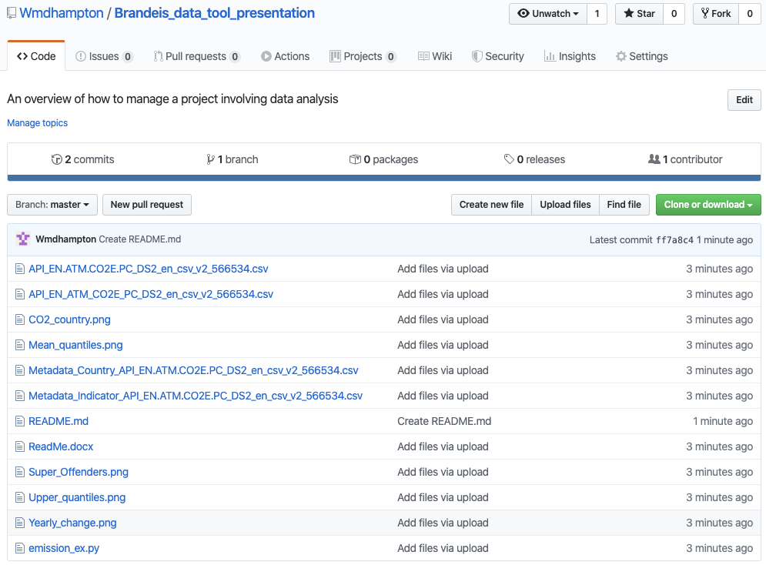
Github Repository
https://github.com/Wmdhampton/Brandeis_data_tool_presentation
All files used for this presentation and more:
This Powerpoint
Resource Doc
Python Code
Python Figures

Slide 8
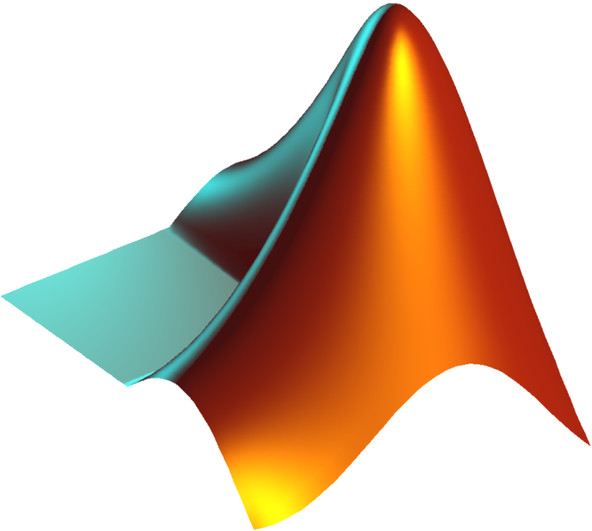


Choose your language
Matlab
Offered by Brandeis
Comes with Integrated Development Environment (IDE)
Many built in libraries
Open source options
Python
R
https://www.brandeis.edu/its/services/software-business-systems/software/index.html
https://www.mathworks.com/products/matlab/getting-started.html
https://www.r-project.org/
https://www.learnpython.org/

Slide 9


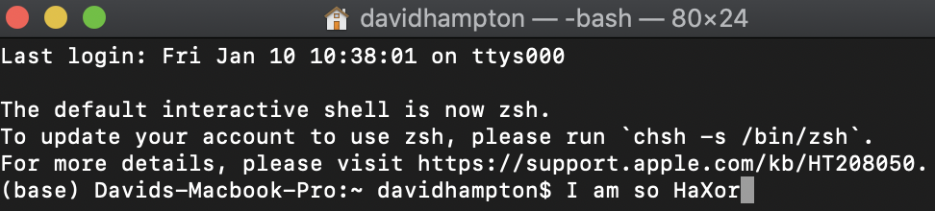
IDE setup
Anaconda Navigator
Supports Microsoft, Mac, Linux
Spyder: Python IDE
JupyterLab: Jupyter Notebook IDE
RStudio: R IDE
Alternative use possible from command line
Anaconda necessary for Microsoft
Anaconda highly recommended for Mac
Command line most useful for Linux
Especially for computationally intensive projects needing a cluster or many cores
https://docs.anaconda.com/anaconda/navigator/
https://www.spyder-ide.org/
https://pythonbasics.org/execute-python-scripts/

Slide 10
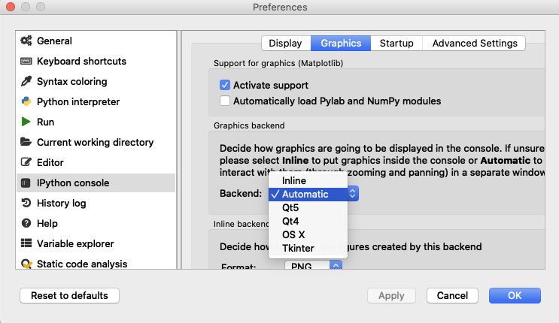
Set IPython graphics to automatic in Spyder
Allows figure creation
File > Preferences >
IPython console
-Backend from Inline to Automatic
(Restart Spyder)
*Note: Can slow down code

Slide 11
Stages of data analysis
Data management and analysis tools
Preliminary analysis/visualization

Slide 12
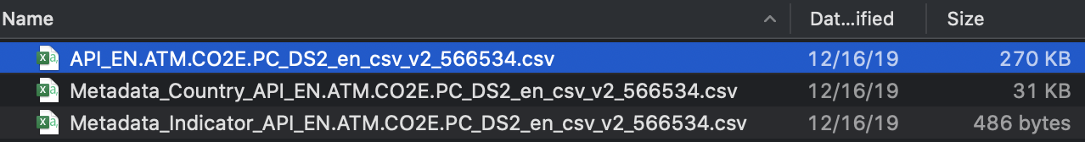
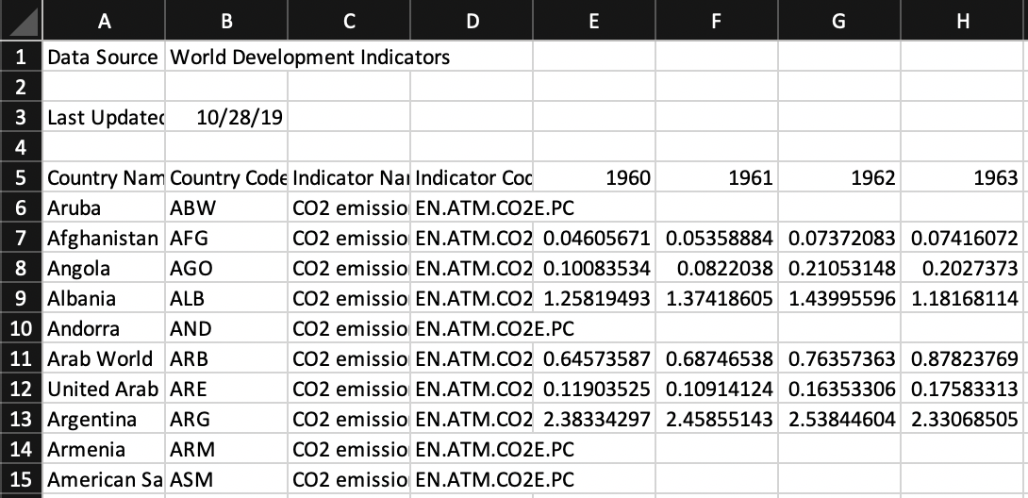
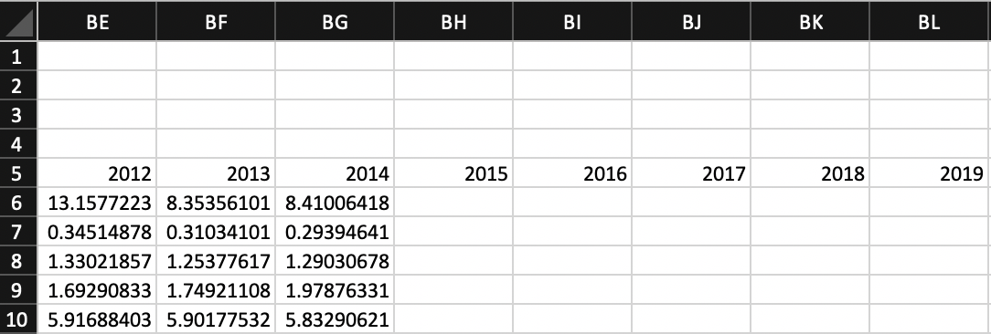
Data Overview
Naming Conventions
Dataframe format

Slide 13
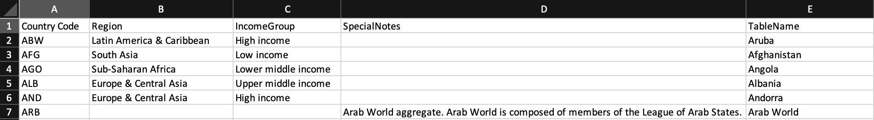
Whoa, that’s meta!
Metadata describes variables and data set.

Slide 14
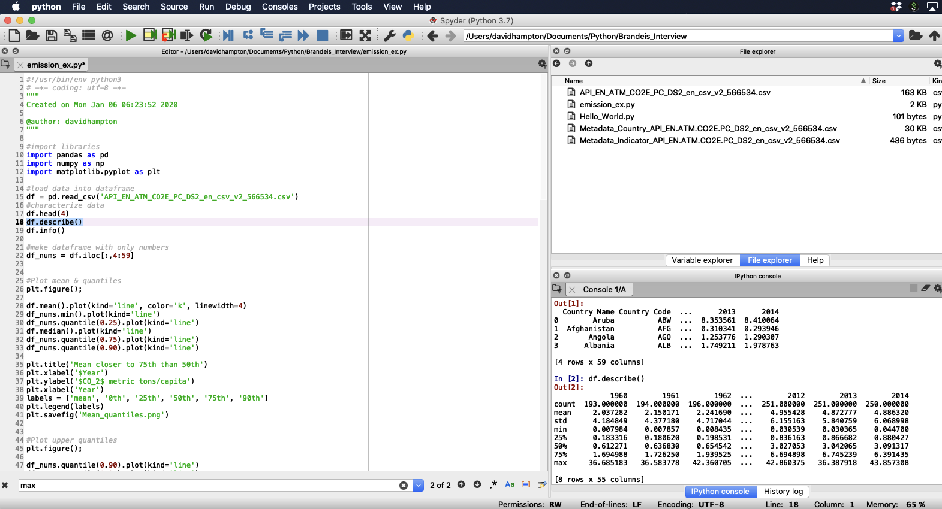
Run
Working directory
Python script
Libraries
Dataframe from .csv
File Explorer
Explore Dataframe
IPython console

Slide 15
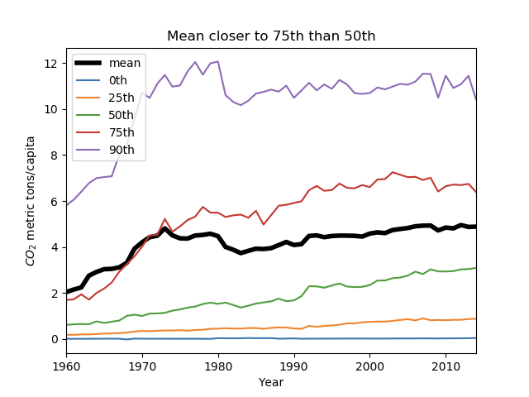
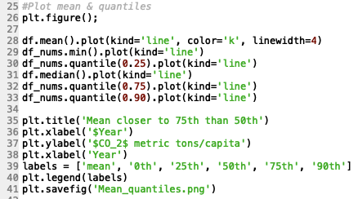
Plotting with pandas
https://www.learndatasci.com/tutorials/python-pandas-tutorial-complete-introduction-for-beginners/
https://pandas.pydata.org/pandas-docs/stable/user_guide/visualization.html
https://www.kaggle.com/learn/overview

Slide 16
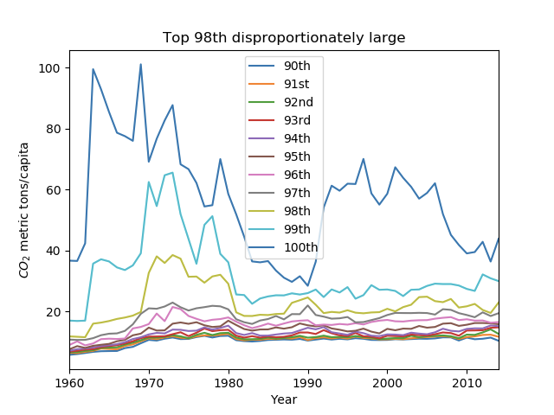
98th percentile are super offenders

Slide 17
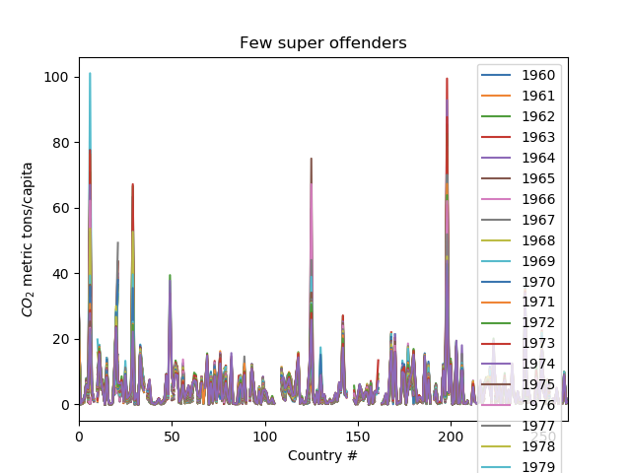
5-20 super offenders

Slide 18
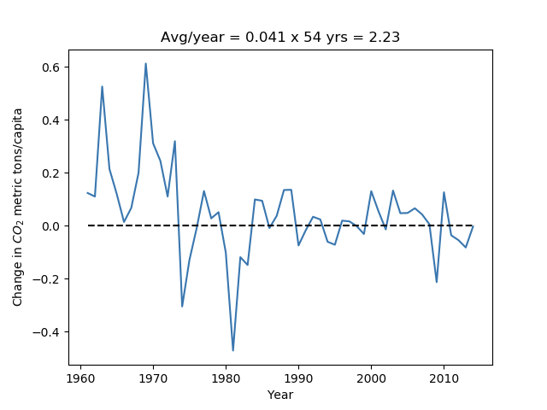
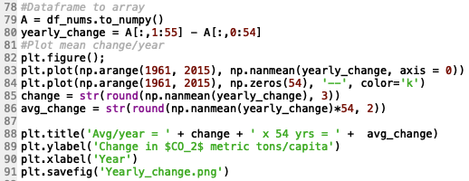
Plotting yearly CO₂ change with numpy & matplotlib
http://cs231n.github.io/python-numpy-tutorial/
https://matplotlib.org/tutorials/introductory/pyplot.html
https://towardsdatascience.com/a-guide-to-pandas-and-matplotlib-for-data-exploration-56fad95f951c

Slide 19
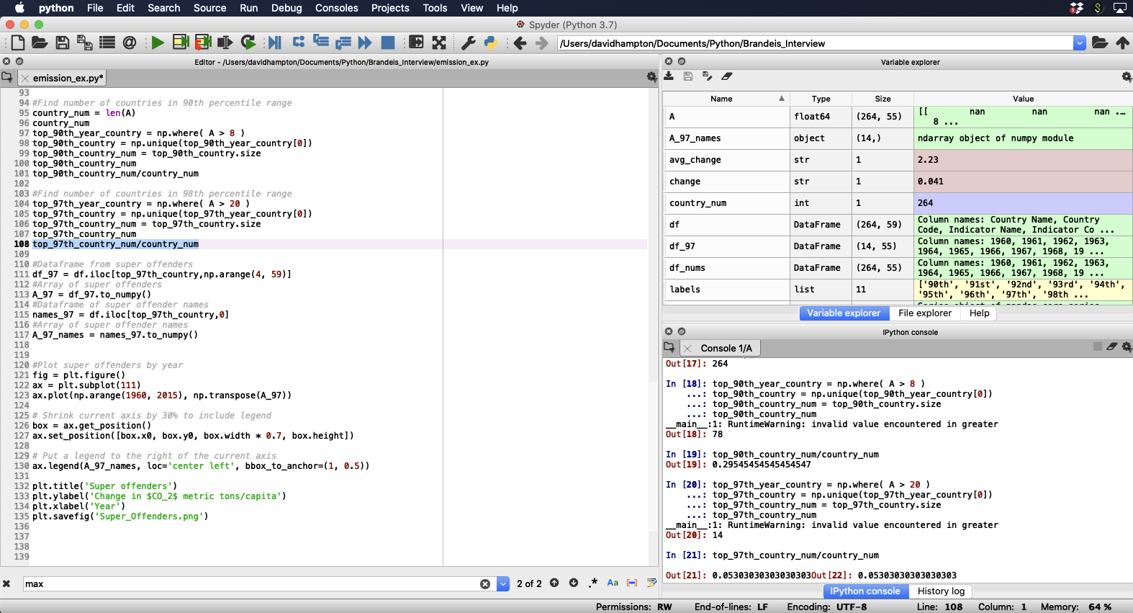

Slide 20
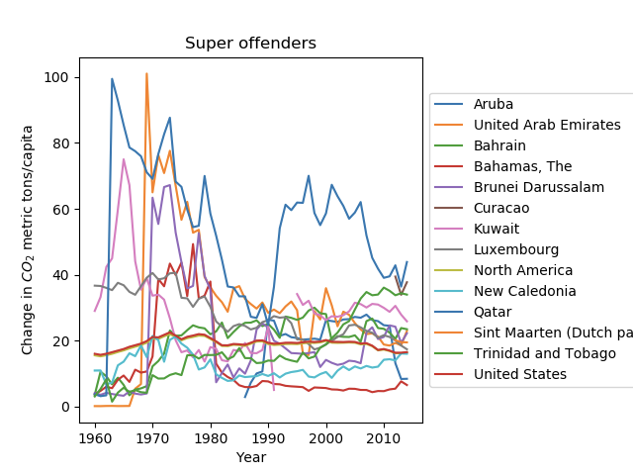

Slide 21
Recap
Data management, analysis & visualization tools
Example use of Github & Python
Ideas for approaching CO₂ emission data set

Slide 22

Questions?
Photo from: https://www.machinedesign.com/community/article/21836908/what-questions-should-you-ask-during-the-product-lifecycle

